Slide 1
Time Management
Julie A. Blendy, Ph.D.
Department of Systems Pharmacology and Translational Therapeutics

Slide 2
You cannot manage time…
But you can mange your life around time

Slide 3
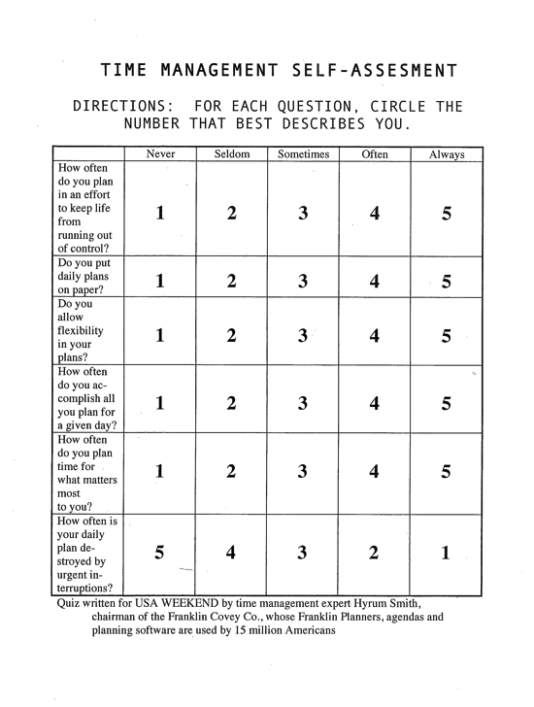

Slide 4
Know how you spend your time…
6-10: Terrible time planner.
You should consider using new tools and processes to help you plan effectively. A great first step would be to take a time management course.
11-15: Below average planner.
You may already have a planning system, but using it more effectively will help to reduce the stress and lack of control you feel in your life.
16-20: Average planner.
Your planning system is working, but you can do better. You may need help focusing on priorities, dealing with urgent interruptions or writing your daily plan.
21-25: Above-average planner.
Your planning system is working well. Keep up the good work, with periodic reviews to be sure you’re planning around what matters most in your life.
26-30: Excellent planner--or candidate for burnout?
You have mastered planning and should experience the serenity that comes from taking charge of your life. But make sure you’re in control of your planning rather than letting it control you.

Slide 5
Protecting your time
Goal Setting: “To-do” or not “to-do” lists
Organize your time into blocks
Identify your “peak productivity” time
Eliminate “time wasters”

Slide 6
Protecting your time
Goal Setting: “To-do” or not “to-do” lists
Organize your time into blocks
Identify your “peak productivity” time
Eliminate “time wasters”

Slide 7
“To Do List” vs “Master List”
Master-list is EVERYTHING you need to do
(may be 20,30,40 or more items)
To –do list is a way of knowing the tasks and demands on your time for TODAY
Invest in a ”planning tool”
electronic planners, pocket diaries, calendars, computer programs, but the best is to always carry a notebook
Notes:
Notebooks are great for jotting down notes, journaling m meeting notes etc, allows you to capture information
And our minds are mean for processing information not necessarily storing it , so. Have something that helps you store it

Slide 8
To-do lists
To-do lists should be captured centrally
(notebook, PD, etc. no sticky notes!)
Maintain and develop a list of specific things to be done for each day*, set your priorities and the get the most important ones done as soon in the day as you can
Evaluate your progress at the end of the day briefly
Prioritize lists
- Eisenhower Matrix
- Must do, Should do, Could do

Slide 9
Eisenhower Matrix
Urgent
Not Urgent
Important
Not
Important
Notes:
Dwight D. Eisenhower was the 34th President of the United States fr
President …is said to have used the comment of a friend, "I have two kinds of problems: the urgent and the important. The urgent are not important, and the important are never urgent." This "Eisenhower Principle" is said to be how the president organized his workload and priorities by recognizing that we must spend our time on things that are important and not just the ones that are urgent. IMPORTANT activities have an outcome that leads to achieving an important “goal” ( i.e. BGS specific?) wheras URGENT activities demand immediate attention, and are usually associated with achieving someone else's goals. They are often the ones we concentrate on and they demand attention because the consequences of not dealing with them are immediate.
Prioritizing tasks by urgency and importance results in 4 quadrants with different work strategies:

Slide 10
Eisenhower Matrix
-Go to class
-Experiments
-Study for exams
-Collect papers for
review article/ thesis/candidacy exam
-Bake a cake
-Make stock solutions
-Run gels
Notes:
Delegation means
assigning responsibility for
a task to someone else,
freeing up some of your
time for tasks that require
your expertise.

Slide 11
Must, Should, Could
Submit date sensitive materials (papers, exams, thesis , grants, paper drafts)
Order antibodies
Inject mice
Listen to friends practice talk
Go to seminar
Install and go thru tutorial of new Endnote program
Quantify Western blot
Run PCR

Slide 12
Must, Should, Could
Submit date sensitive materials (papers, exams, thesis , grants, paper drafts) MUST
Order antibodies SHOULD
Inject mice MUST
Listen to friends practice talk COULD
Go to seminar MUST/SHOULD/COULD
Install and go thru tutorial of new software program COULD
Quantify Western blot MUST/SHOULD
Run PCR MUST/SHOULD
Notes:
anti-to -do list people argue that 40% of what is on a to-do ist never gets done and they endorse going by a calendar..which in many ways is just a to do list adjusted for time
so I often have a weekly to do list , which waxes and wanes over time , but it allows you to keep that monkey brain quiet, such a list helps you from then going from one task to the next and interrupting you concentration on one task because you just remembered something else you should do ..
.....which brings me to the next point of organizing your time into blocks

Slide 13
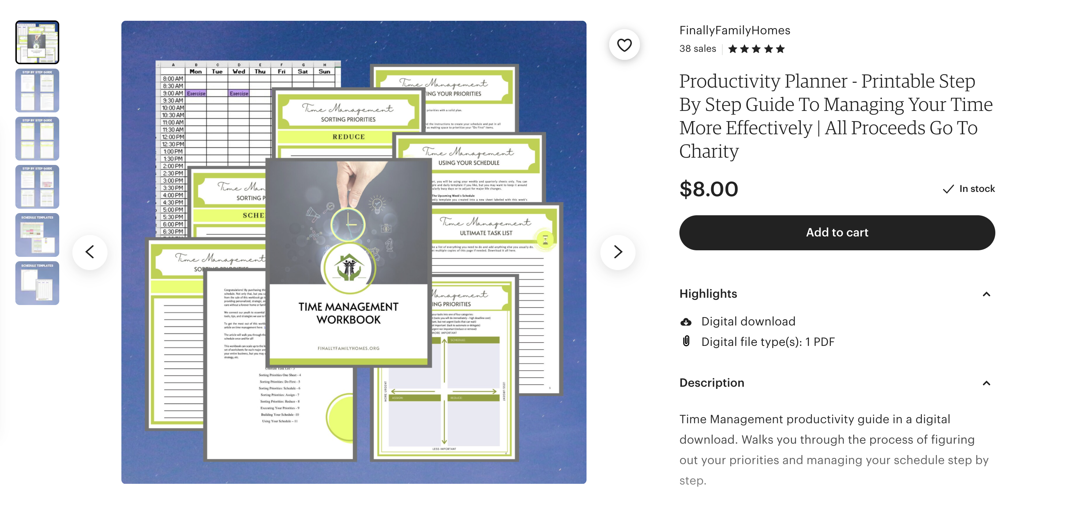

Slide 14
Protecting your time
Make “to-do” lists
Organize your time into blocks
Identify your “peak productivity” time
Eliminate “time wasters”

Slide 15
Time blocks
Focus on one task at a time; in blocks of time and be realistic about constraints on time
Block out time to plan and accomplish high priority tasks
Limit scheduled time to ¾ of your day - unscheduled time is very important!
Notes:
24 hrs in the day, hopeuflly you all get about 8 hrs of sleep that leaves 16 so dont schedule more than 12 hrs
I am not ssaying you need to work or study for 12 hrs ..you should schedule excercise and netflix time but leave some time unscheduled because as you click often on websites,,,you are not a robot !

Slide 16
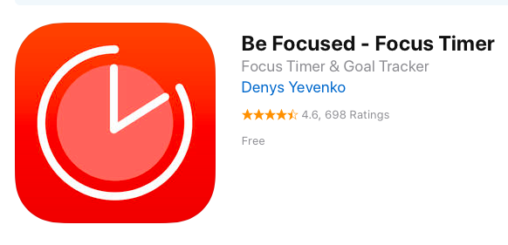
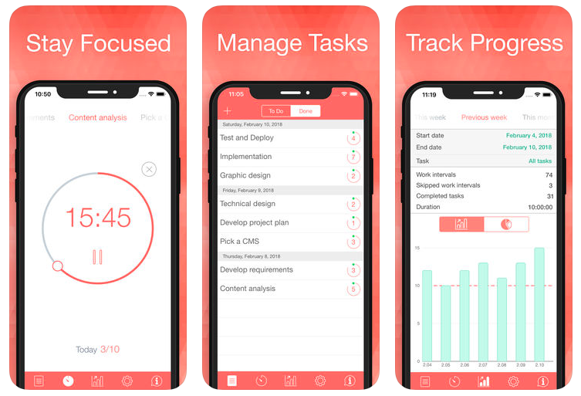
Time blocks and peaks in productivity
Focus on one task at a time; in blocks of time and be realistic about constraints on time
Pomodoro Technique:
Divides work into small
increments with scheduled
breaks

Slide 17
Protecting your time
Make “to-do” lists
Organize your time into blocks
Identify and use your “peak productivity” time
Eliminate “time wasters”

Slide 18
Peak Productivity Time
Studies show the first 2 hours of the day you are
at your cognitively best
-Plan your most challenging tasks for when you have the most energy.
-Course work is pre-arranged but research time is flexible
  - Reading papers and outlining experiments require more concentration=peak productivity slots
  - Some experimental work =non-peak slots
-Block out time for your high priority activities first and protect that time from interruptions.
Notes:
Morning v evening people ..this is not related to your circadian biology
If your start your day at 7 or 10 .. Use the first 2 hrs fo your day ..when you are most fit to work on the most challenging task

Slide 19
Protecting your time
Make “to-do” lists
Organize your time into blocks
Identify your “peak productivity” time
Eliminate “time wasters”

Slide 20
Eliminate “time wasters”
Value your time and be ruthless about safe-guarding it
only 1440 minutes in a day, so value each one
Your “digital life”
Work
Store files
Play games
Watch movies
Email
Tweet
Attend webinars
Edit and store photos
Write
Reading
Find recipes
Zoom

Slide 21
Declutter your digital life…
Weekly
Back up files
Clean up desktop
E-mail – triage daily and respond to time sensitive items ;clean weekly
Empty trash
Take one day off
Monthly
Empty downloads folder
Review application folder- if not using, uninstall
Annually
Assess social media channels – two many friends of Facebook, turn off notifications, stope pinning recipies and start cooking them
For Apple Users- visit the Genius Bar once a year

Slide 22
Procrastination- the biggest time waster of all
Think about ways you can sabotage your future procrastinating self
Break down tasks into smaller segments that require less time
Set realistic deadlines for each specific accomplishment and reward yourself for completing
Getting started may require some preparatory time (organize papers, talk with experts, clean off your desk)

Slide 23
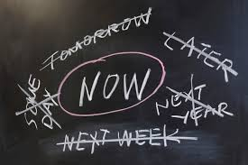
Helpful Tips for Time Management
Each day identify your MIT and complete that task first
(Most Important Task)

Slide 24

Helpful Tips for Time Management
Learn to say no
“If you want something done , ask the busiest person to do it”
Only take on commitments that you know you have time for and you care about

Slide 25

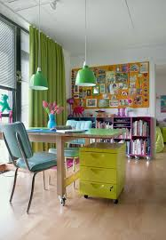

Helpful Tips for Time Management
Devote your entire focus to the task at hand
close out browser window, put away phone, find the right environment
Notes:
FULL IMMERSION

Slide 26
Helpful Tips for Time Management
Get an early start
Get a good sense of how long tasks take and plan accordingly
Delineate a time limit in which to complete tasks and reward, reward, reward yourself for finishing a given task.

Slide 27
Helpful Tips for Time Management
Sleep and exercise and eat healthily

Slide 28
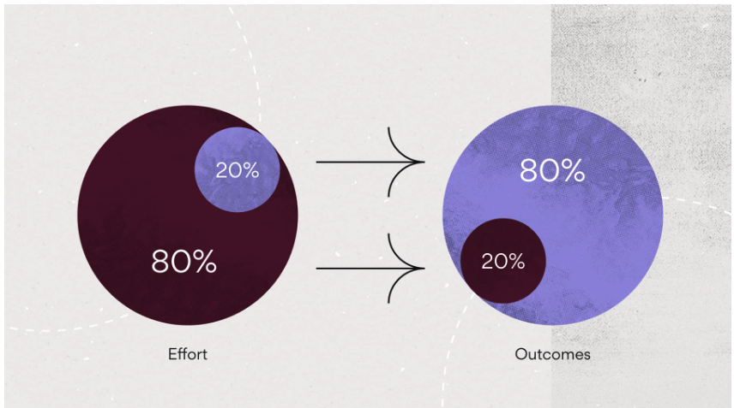
Helpful Tips for Time Management
Pareto Principle- 80:20 rule
- an adage which asserts that 80% of results come from 20% of actions
Identify what are the handful of tasks that are going to pay off the most?

Slide 29
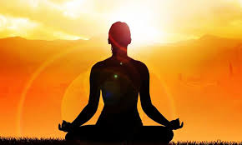
So don’t forget to maintain a good work life balance
Notes:
Graduate school sets the stage for your professional life…taking the time in this relatively safe space ( your paycheck is secure, your job description is clear , the expectations are understood) to now develop your own strategies for working and playing will be so beneficial in the long run

